Slide 1
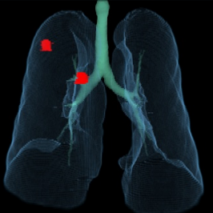
`
AI-powered Precision Analytics Solution for
Ultra-low-dose CT Lung Cancer Screening
With the unique built-in features including powerful denoising and kernel normalization, ClariPulmo provides accurate and consistent detection and measurement results despite the heterogeneous scan and reconstruction conditions which are frequently encountered in real world environments.
Tri-functional Lung Analytics
Low Attenuation Area (LAA)
Analysis
Lung Nodule Detection &
Analysis
High Attenuation Area (HAA)
Analysis
Noise-Robust Quantification
Emphysema
Detection & Quantification
Solid / Part-Solid / GGN
Precision Quantification & Classification
GGO / Consolidation
Unique built-in features include powerful Ai-denoising and kernel normalization
Enables accurate and consistent characterization in heterogeneous LD CT scan conditions
Guarantees robust performance with any existing CT scanners

Slide 2
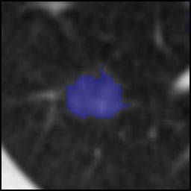
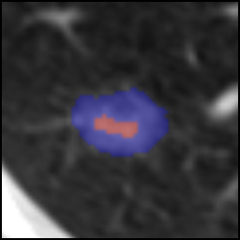
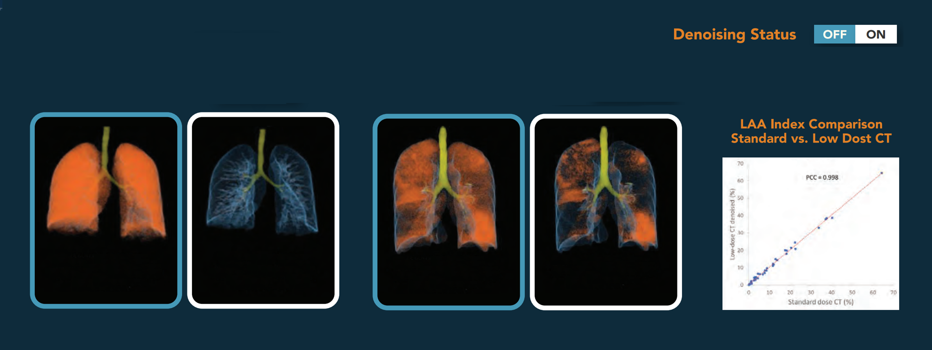
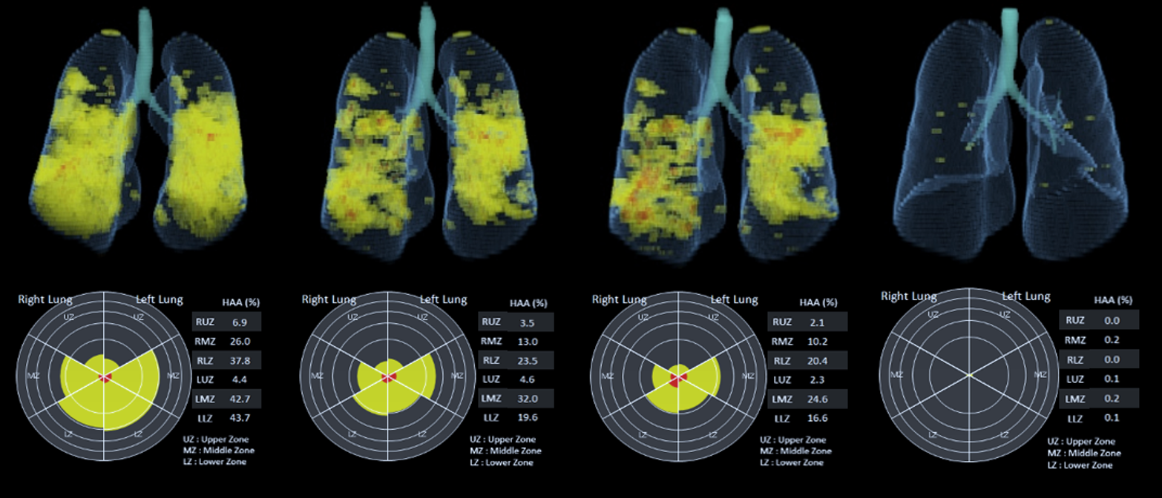
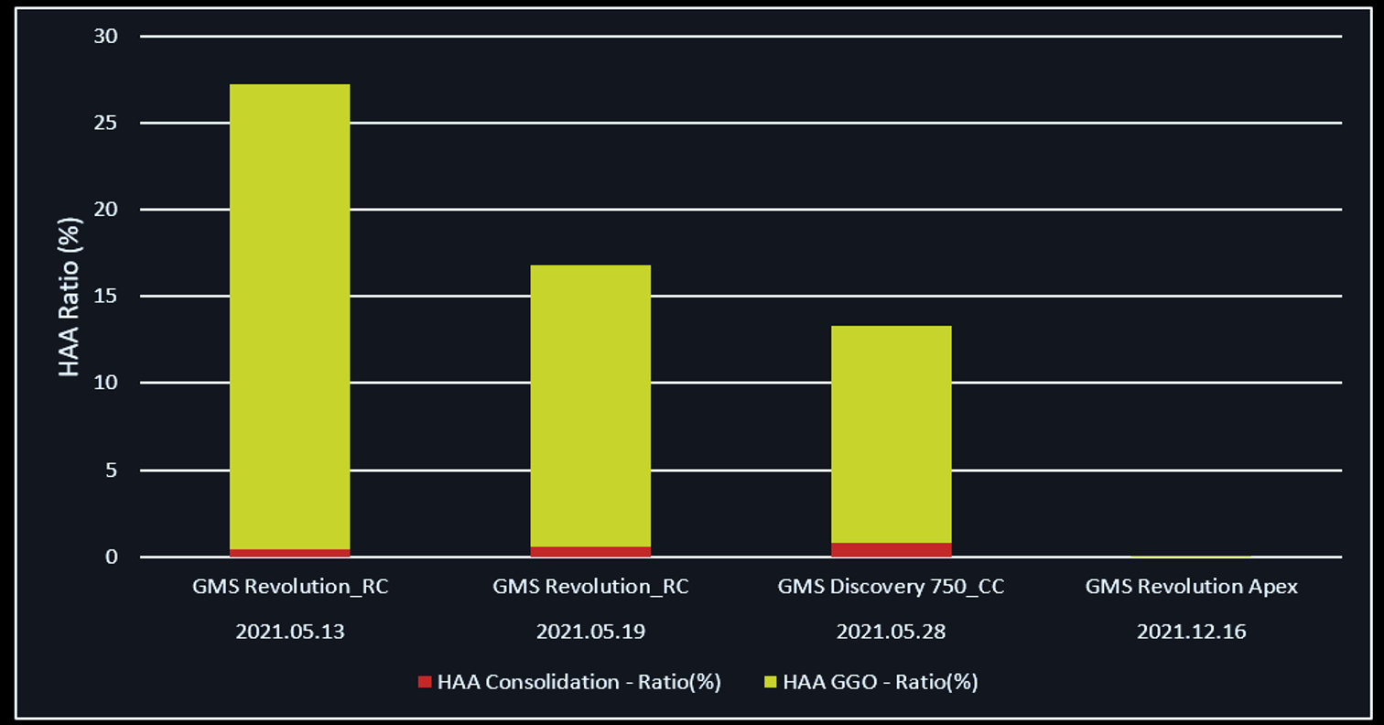
`
ClariPulmo is designed to support the physician in detecting, quantifying, reporting of lung lesions with highly reliable performance by a unique combination of AI algorithms.
The software provides tri-functional precision analyses of lung lesions such as lung nodule, emphysema, and other high attenuation lesions.
Detection
Classification
Volumetry
Growth
Categorization
VDT 92 days, Growing
Ground Glass Nodule
Total Volume | 8$28 {mm}^{3}$
Solid Component | 1$6 {mm}^{3}$
Diameter | 14 mm
Type | GGN
Part-Solid Nodule
Total Volume | 1167${mm}^{3}$
Solid Component | 234${mm}^{3}$
Diameter | 16 mm
Type | Part Solid
Noise-Robust Precision Emphysema Analysis
Patient without Emphysema
Patient with Emphysema
%LAA: 30.8
15 Perc: - 1024 HU
TLV: 2.24 L
%LAA: 0.21
15 Perc: - 851 HU
TLV: 2.40 L
%LAA: 15.7
15 Perc: - 965 HU
TLV: 5.23 L
%LAA: 8.45
15 Perc: - 933 HU
TLV: 5.30 L
Surveillance Report of High Attenuation Lesions

